Slide 1
Self Driving Car:
Lane Detection
RelaxAuto

Slide 2
Contents
Motivation
Dataset
Preprocessing
Augmentation
Training Results
Deployment
Areas for Improvement

Slide 3
Motivation
Enable a vehicle (JetBot) to navigate with autonomously with images captured from a single-lens camera.
Improve road safety!
Allow disabled personnel to reach their destinations in a safe and timely manner.

Slide 4
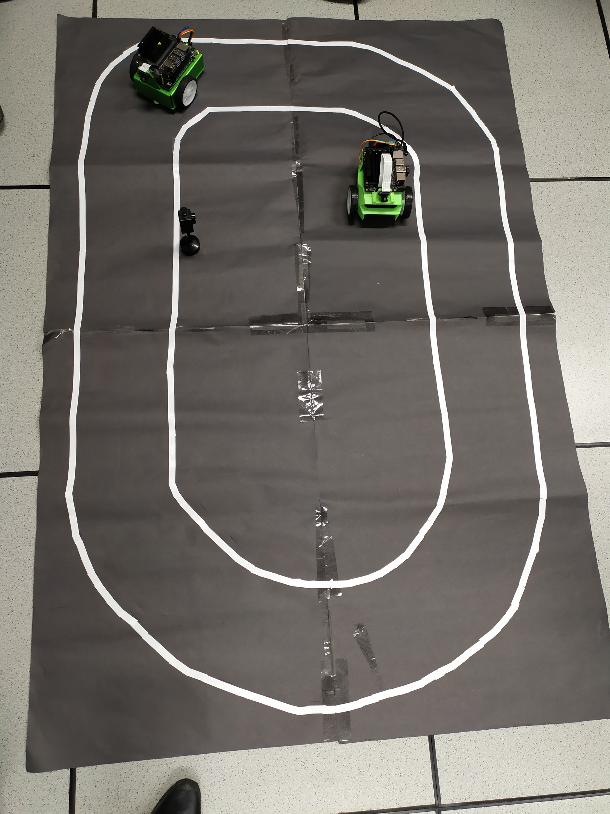
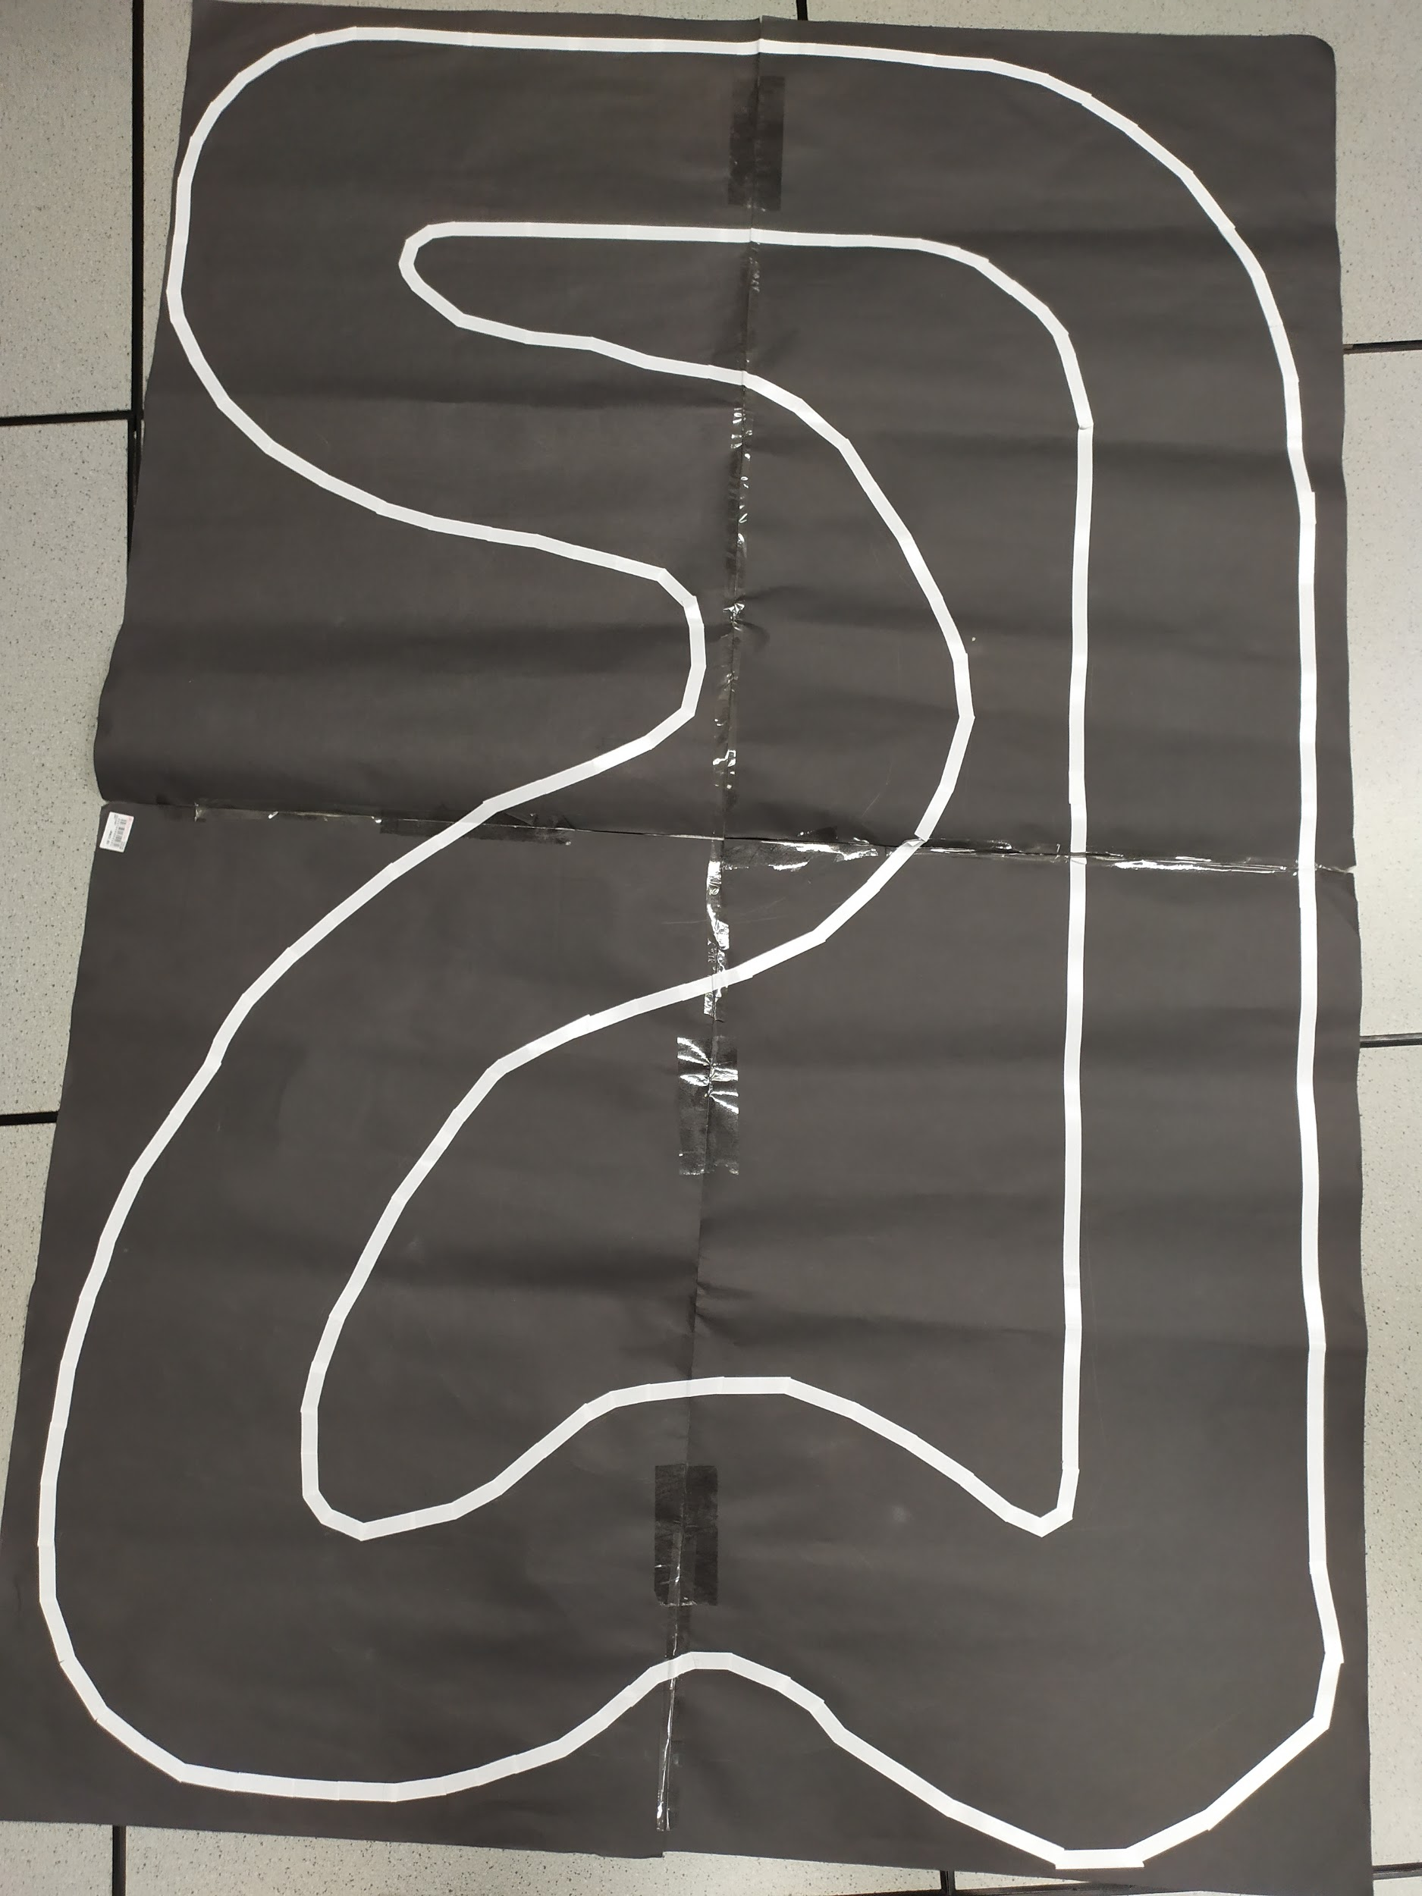
Tracks
Materials: 4 x Black sugar papers, white color tape
Training Track
Evaluation Track

Slide 5
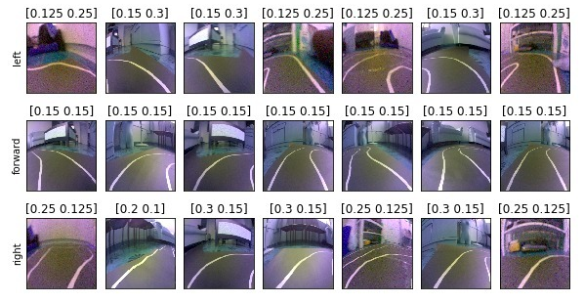
Dataset

Slide 6
Preprocessing (Why?)
Too much information (TMI)
Road occupies half of the image.
Organize into sequences for CNN-LSTM model.
Data Normalization
Faster convergence, shorter training time.

Slide 7
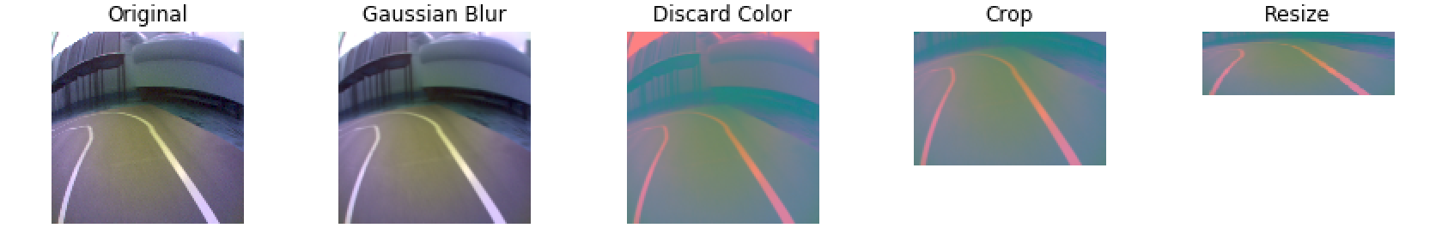
Input Preprocessing Method 1 Cropping and Discard Color
Top Crop 30% to make the model focus on ground
Gaussian Blur for bokeh effect.
Color BGR to YUV.
Resize into model input
Normalize input data to color_value/255

Slide 8
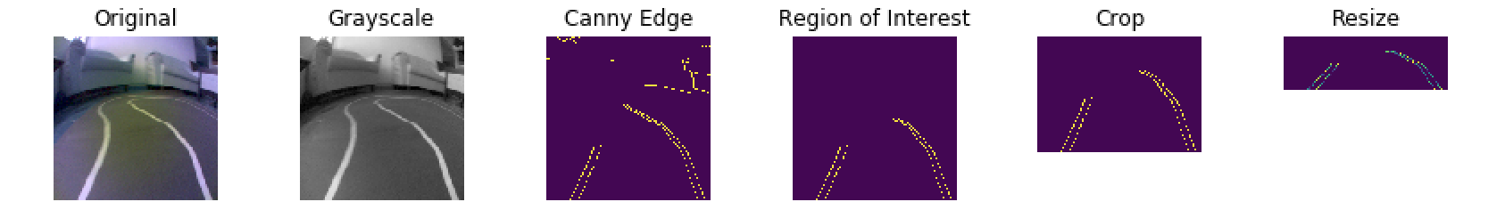
Input Preprocessing Method 2 Lane Masking using OpenCV
Convert to grayscale.
OpenCV Canny Edge Detection.
Background noise removal.
Crop and resize.
Notes:
Image is first turn to grayscale, follow by OpenCV Canny Edge detection and the background noise is removed. Follow up is using a polygon and remove the edges in top part of the photo, to return of a region of interest. Now the image is focus on the curve of the lane.
** The draw back of the method would be many information other than lanes are removed. For other prediction or detection will required additional preprocessing step for it.

Slide 9
Label Processing- One Hot Encoding
Left and right motor values (e.g [0.5,0.25])
Convert to one hot
Left [1,0,0]
Straight [0,1,0]
Right [0,0,1]

Slide 10
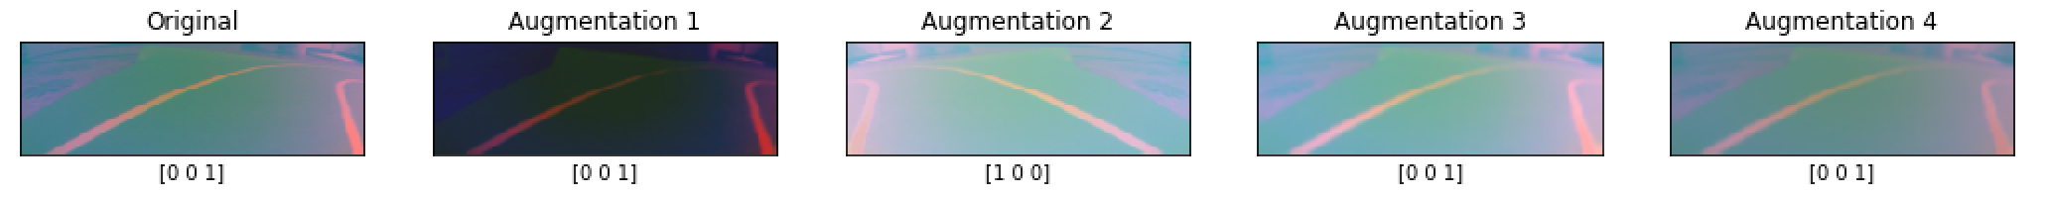
Image Augmentation
Data is first pre-process then fit into the model with custom image generator. Augmentations below are applied to generate more variant of data and make the model robust to different scenarios.
Blurring & Brightness adjustment - Handle glaring effect
Horizontal flip (with label) - Generate more data
Channel shifting - Handle lighting effect such as sunlight, streetlight, under shadow/shades.
Random Zoom (10%)
** Other than horizontal flip, the rest of augmentations only applicable to pre-processing method 1 which consist of 3 channel.
Notes:
Blurring &Blurring & Brightness adjustment - to handle glaring
Horizontal flip (with label) - generate more data
Channel sBlurring & Brightness adjustment - to handle glaring
Horizontal flip (with label) - generate more data
Channel shifting - to handle different lighting effect
Random Zoom (10%)
hifting - to handle different Blurring & Brightness adjustment - to handle glaring
Horizontal flip (with label) - generate more data
Channel shifting - to handle different lighting effect
Random Zoom (10%)
lighting effect
Random Zoom (10%)
Brightness adjustment - to handle glaring
Horizontal flip (with label) - generate more data
Channel shifting - to handle different lighting effect
Random Zoom (10%)

Slide 11
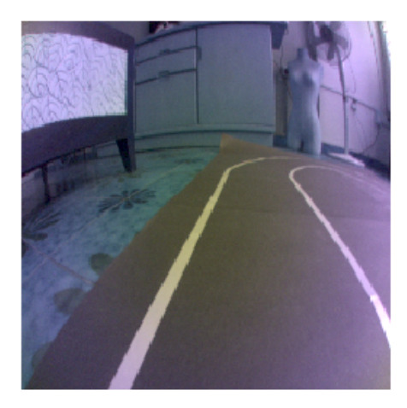
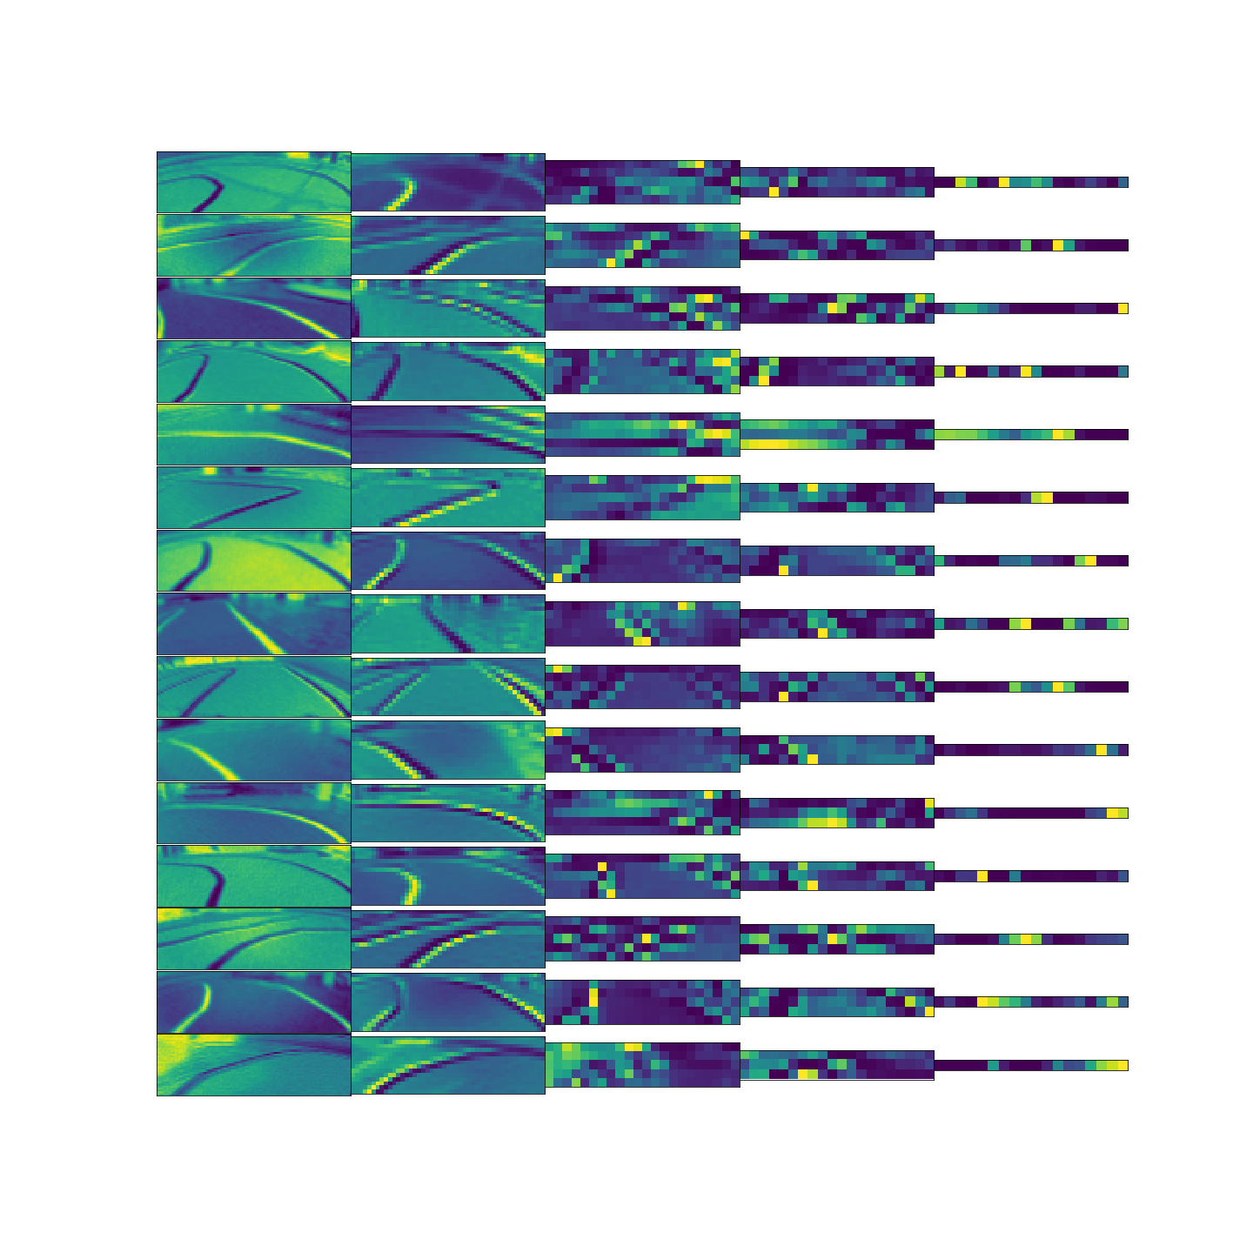
Model 1 - CNN : Architecture
5x5
5x5
5x5
Flatten
Dense
3x3
Dense
Dense
3x3
CNN feature extraction:
Total Params | Model Size | Inference Speed
252,241 | 3mb (.h5), 1mb (.tflite) | 30fps (.h5), 40fps(.tflite)

Slide 12
Model 1 - CNN : Hyper-parameters
Parameters | Value
Activation Function (CNN & Dense) | Exponential Relu
Activation Function (Output) | Softmax
Dropout | 0.4 after flatten layer
Learning Rate | Initial 0.003, learning rate schedule to drop 10 % by every 5 epoch trained
L2 Regularization | 0.001
Batch Size | 128
Epoch | 100, early stopping by 20 epochs
loss | Categorical Cross Entropy

Slide 13
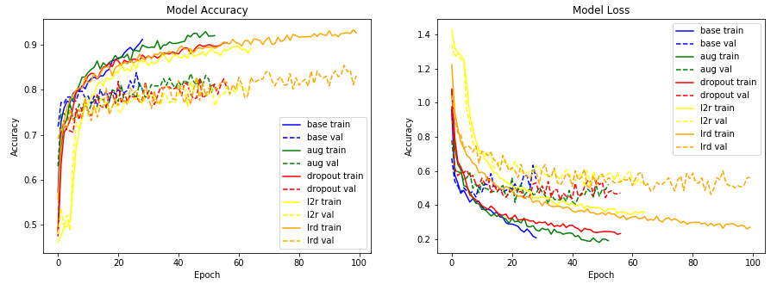
Model 1 - CNN : Results - Accuracy & Loss

Slide 14
Model 1 - CNN : Classification Report
 | BASE | AUGMENTATION | DROPOUT | L2 Regularization | ALL + Learning Rate Decay
F1-Left | 0.8 | 0.82 | 0.81 | 0.79 | 0.84
F1-Forward | 0.8 | 0.83 | 0.82 | 0.82 | 0.84
F1-Right | 0.67 | 0.74 | 0.72 | 0.75 | 0.8
Precision-Left | 0.82 | 0.87 | 0.88 | 0.88 | 0.83
Precision-Forward | 0.74 | 0.76 | 0.75 | 0.75 | 0.81
Precision-Right | 0.83 | 0.88 | 0.87 | 0.84 | 0.88
Recall-Left | 0.79 | 0.77 | 0.75 | 0.71 | 0.85
Recall-Forward | 0.87 | 0.91 | 0.92 | 0.9 | 0.87
Recall-Right | 0.56 | 0.64 | 0.61 | 0.68 | 0.73
Weighted Average | 0.77 | 0.81 | 0.8 | 0.79 | 0.83

Slide 15
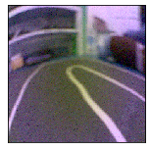
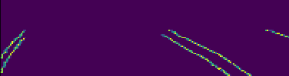
Model 2 - CNN + LSTM : Architecture
P(Left), P(Center), P(Right)
LSTM
LSTM
PilotNet
~800k parameters.

Slide 16
Model 2 - CNN + RNN : Hyper-parameters
256 Images per batch (Could be more due to flip left right).
Leaky Relu activation.
Adam Optimizer with learning rate 0.001.
100 Epochs.
Early stop when no improvement on validation loss after 20 epochs.

Slide 17
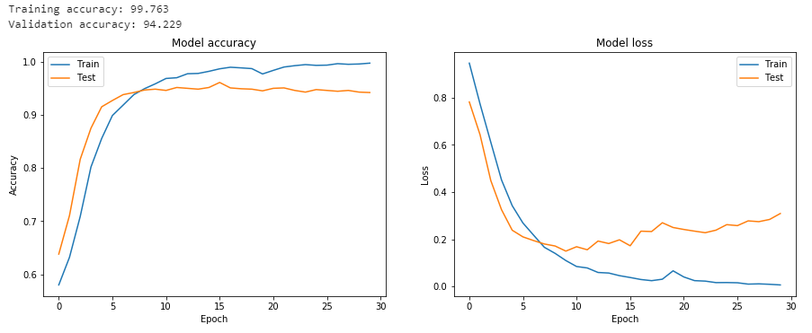
Model 2 - CNN + LSTM: Results

Slide 18
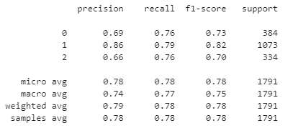
Model 2 - CNN + LSTM: Results

Slide 19


Deployment
Deploy Model

Slide 20
Deployment (In-depth)
Pull from https://github.com/relaxauto/models
Load desired model file name.
Get model’s input layer shape
Determine various preprocessing parameters.
Run the robot.

Slide 21
Areas for Improvement?
Dataset
Improve in quality of dataset
Tuning of more hyperparameters
Number of units in the networks.
Momentum values in optimizers.

Slide 22
Demo

Slide 23
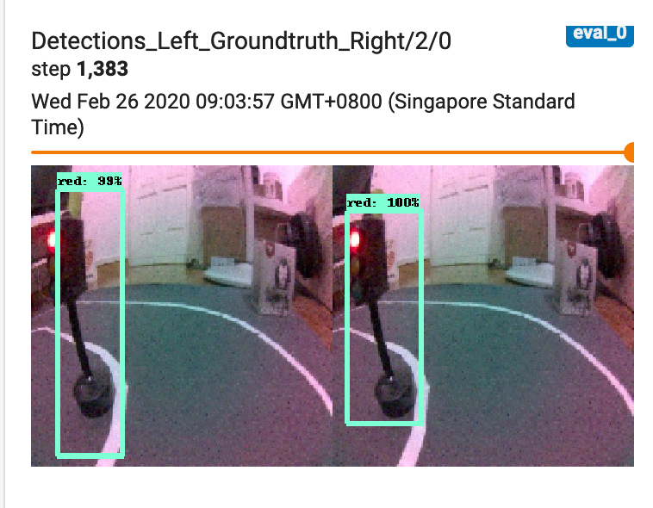
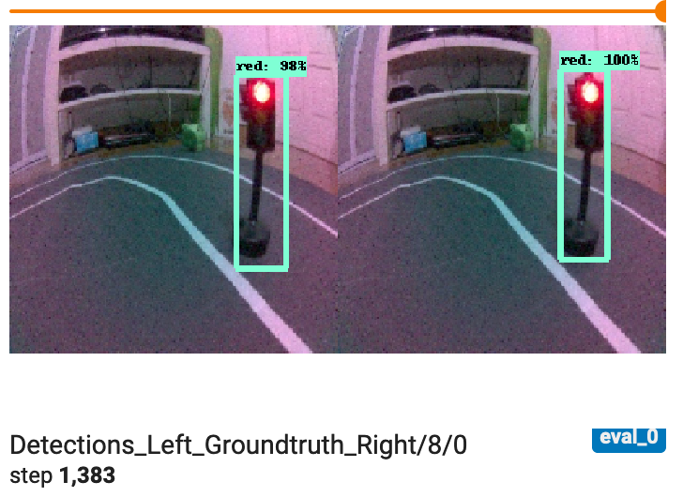
Integration with TFOD for Traffic Light
Def execute(change): Capture image data from change[‘value’] Reshape data and feed into run_inference_single_image and get value of y2, y1, classes, confidence scores, and number of boxes. If there is amber or red light detected with high confidence, calculate height by difference between y2,y1. If the height of the box is equal to half or more of the shape, stop the robot. Otherwise, run second inference on lane detection model and move on. Loop.

Slide 24
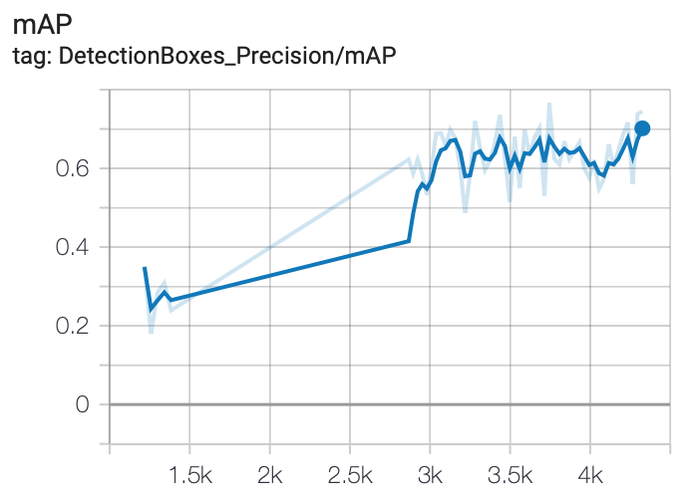
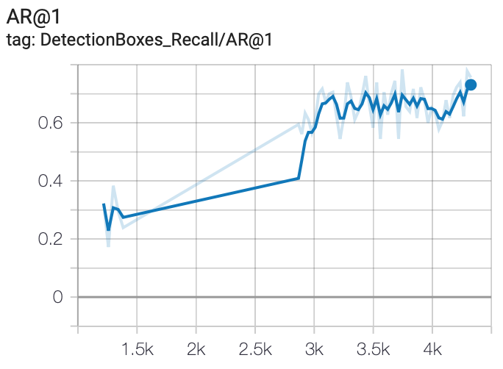
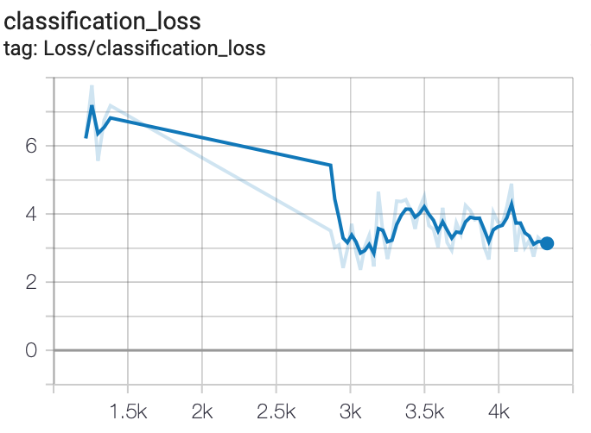
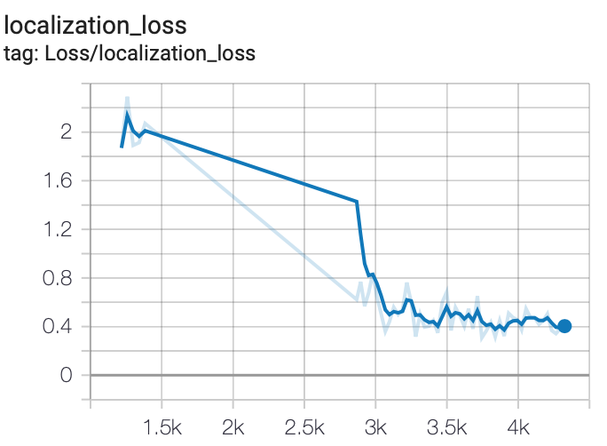
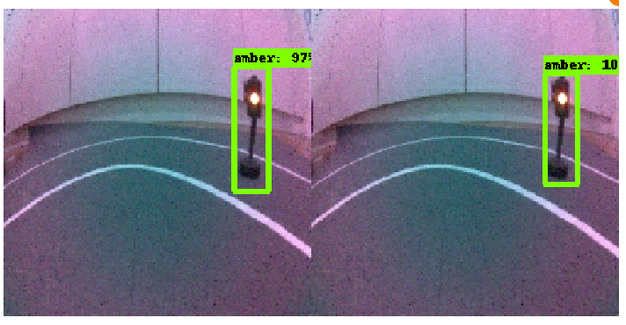
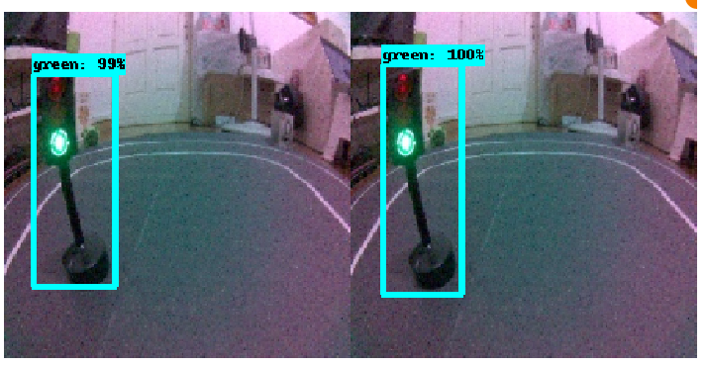
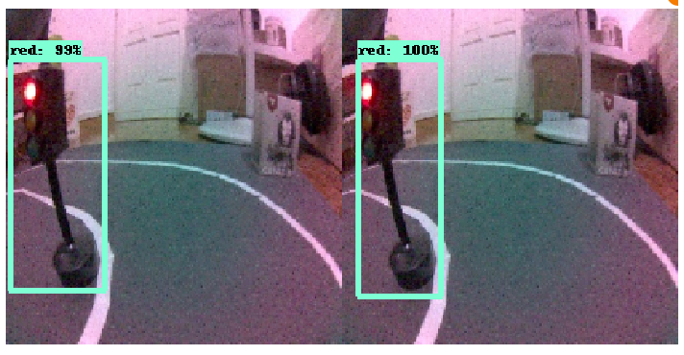
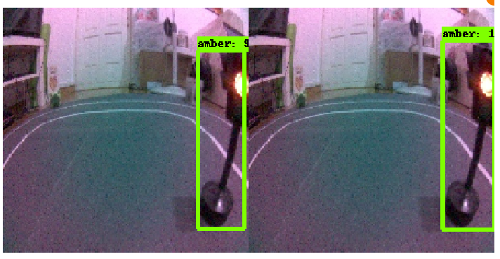
TFOD Performance
Detection Box Precision, mAP
Detection Box Recall, AR
Classification Loss
Localization Loss
Samples

